Slide 1
Boyer Moore Algorithm

Slide 2
BAD SYMBOL SHIFT(d1)
Example:
1st iteration
TEXT: SEN
PATTERN: BURDEN
In the above example the character S and D are not matching, since the value of k is 2 i.e. number of matching characters, E and N.
The value of d1=t(S)-k
d1= t(S)-k
= 6-2
= 4 (non matching character)
t(S) is equal to the length of pattern i.e. 6 (since S is not their in the pattern)
d1=max{t(c)-k,1}

Slide 3
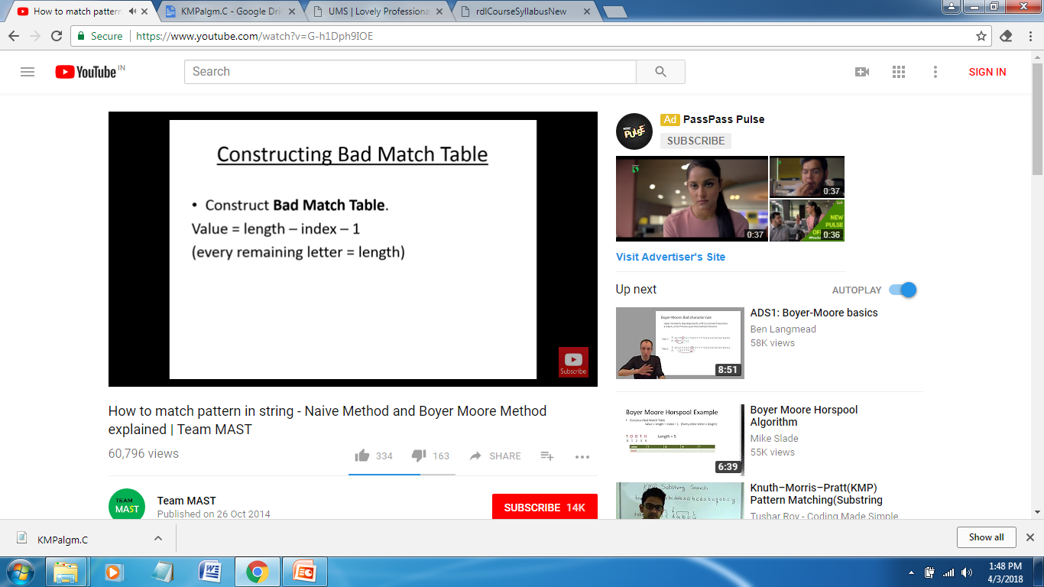
BAD SYMBOL SHIFT(d1)
Example:
TEXT: UEN
PATTERN: BURDEN
In the above example the character U and D are not matching, since the value of k is 2 i.e. number of matching characters, E and N.
The value of d1=t(U)-k
d1= t(U)-k
= 4-2
= 2 (non matching character)
t(U) is equal to 4 (since U is their in the pattern)
Shift value of U is calculated as:
Index of U in pattern: 1
Value= 6-1-1
6 is length of the pattern, 1 is index

Slide 4
GOOD SUFFIX SHIFT(d2)
This is created based on the pattern.
Suppose the pattern is EBDBEB
Need to check the suffix has same number of characters in prefix
K Pattern d2
EBDBEB 2 one character considered i.e. B so k=1. Then find out the 1st occurrence of B in the pattern which is at 2nd position.
2 1
2 EBDBEB 4 two character considered i.e. E B so k=2. Then find out the 1st occurrence of EB in the pattern, which is at 4th position.
4 3 2 1

Slide 5
GOOD SUFFIX SHIFT(d2)
EBDBEB 4 three character is considered BEB which is not their in the prefix. So since 2 characters are only matching. Then find out the 1st occurrence of EB in the pattern, which is at 4th position.
EBDBEB 4 Four character is considered DBEB which is not their in the prefix, 3 character BEB is also not their, 2 character EB is their so we will write its position i.e. 4.

Slide 6
Calculation of d2
BAOBAB
K PATTERN d2
BAOBAB 2
BAOBAB 5
BAOBAB 5

Slide 7
BOYER MOORE ALGORITHM
1 For the given pattern and the alphabet used in both pattern and text, construct a bad symbol shift d1 as d1=t(c)-k, where t is the shift table and k is the number of matching character. If d1 is negative, then shift size should be 1
d1=max {t(c)-k,1}
2 Using the pattern, construct the good suffix shift d2.
3 Align the pattern against beginning of the text.
4 Repeat these steps until a matching substring is found or the pattern reaches beyond the last character of text.
Starting with the last character of the pattern , compare the corresponding characters of pattern & text.
If characters does not match after some comparison the shift size d is calculated as
d={d1 if k=0
max{d1,d2} if k>0}

Slide 8
TEXT: BESS_KNEW_ABOLIT_BAOBAB PATTERN: BAOBAB
1ST ITERATION
BESS_KNEW
BAOBAB
K Pattern d2
BAOBAB 2
BAOBAB 5
BAOBAB 5
No. of matching character is zero no need to go for d2 go for d1
Shift table t
A B O C D E F *
1 2 3 6 6 6 6 6

Slide 9
d1=t(k)-0
=6-0=6
BESS_KNEW_ABOUT_BAOBAB
BAOBAB
K=2 d1=6-2=4
d2=5
BESS_KNEW_ABOUT_BAOBAB
BAOBAB
K=1 d1=6-1=5
d2=2
Max(5,2)=5
BESS_KNEW_ABOUT_BAOBAB
BAOBAB
Finally after shifting 5 characters we reach to a solution where the complete pattern is matching with text.

